Slide 1
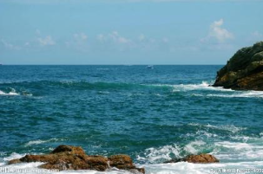
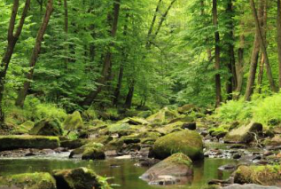

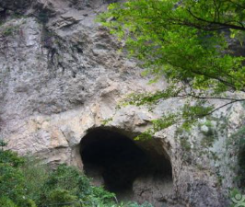
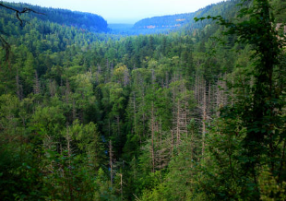
Jungle
Cave
forest

Slide 2
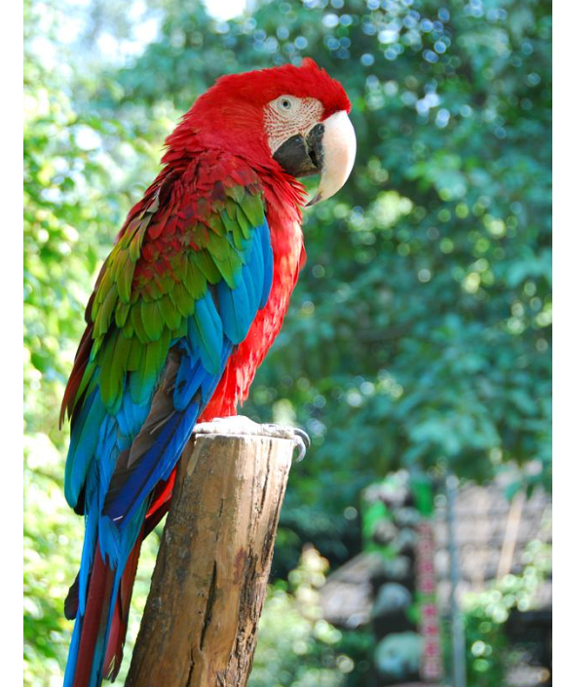
beak
feathers
wings

Slide 3
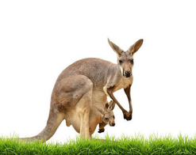
fur
pouh
tail

Slide 4


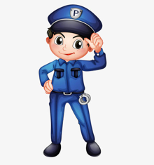
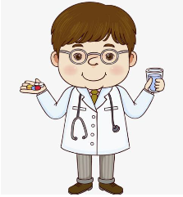
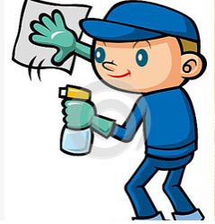
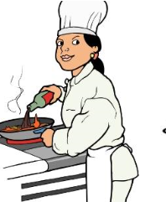
teacher
vet
police officer
doctor
cleaner
chef

Slide 5

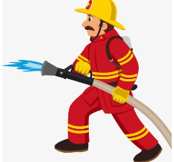
office worker
firefighter

Slide 6


1. What does he do?
He is a teacher.
1. What do they do?
They are doctors.
2. What do he do?
He is a teacher.
2. What does they do?
They is doctors.
3. What does he does?
He is a teacher.
3. What do they does?
They are doctors.

Slide 7

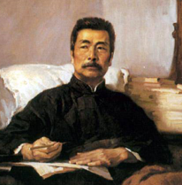
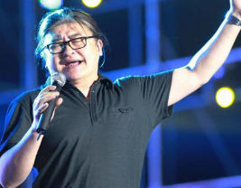
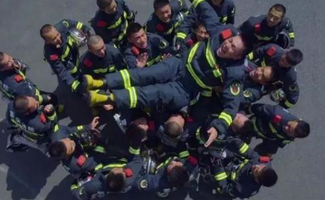
Q: What____ he____?
A: He ___ a _____.
Q: What____ he____?
A: He ___ a _____.
Q: What____ they____?
A: They ___ _____.

